Slide 1
Smart shopping app (Shopper by GASAX)
The best sustainable shopping experience
Team members: Adelric, Armin, George, Stanko, Xiang

Slide 2

Sustainable development goals

Slide 3


Sustainable development goals

Slide 4
Smart shopping app
Customer behavior learning and providing recommended products based on user shopping habits.
Show user statistics, products they buy often, etc...
Show nutrition info of the products to keep track of the consumption and promoting a healthy lifestyle.
Image thumbnails, show the nearest to expiry products and the rest in a stack.
AR Mapping of available space you have at home e.g. drawers/freezer deck/cupboards to determine what items you can or cannot purchase based on dimensions/measurements.

Slide 5
Smart shopping app
Sustainability goals
We can use the data for medical purposes to link medical conditions with the the diet consumed by people.
Will reduce food waste by reminding the user of expiration date of the products.

Slide 6
Smart shopping app
Business model
Sell the right to use the app by the supermarkets, so they can place their discounted products and promotions.

Slide 7
Smart shopping app
Future scalability
Produce statistics from the app to be used by production companies, so they can anticipate the stock for the upcoming production period and avoid mass production.
Predict the food waste of specific regions by AI algorithms with learning users’ habits, and raise the awareness about food waste by ads etc.

Slide 8
Smart shopping app
Technology used
Kotlin with Android Studio
ARCore Google
Grocery stores API

Slide 9
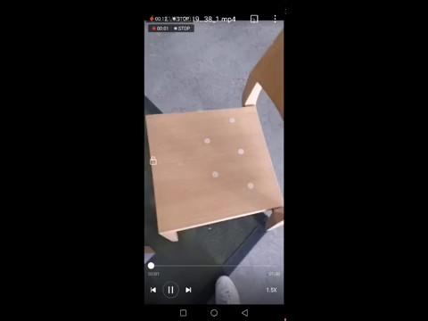

Slide 10

Thank you!

